Slide 1

Slide 1
JOB MARKET IN INDIA rn
Bambhari

Slide 2
Slide 2
Context
This analysis is based on a compiled dataset of job postings, industry salaries, skill requirements, and hiring trends across Indian job market today. The primary objective is to understand the current job market landscape, with a focus on the relationship between experience levels, salary patterns, skill demand, and hiring concentration.
By visualizing distributions across experience categories, average salaries by industry, top in-demand skills, and the companies/locations driving the most hiring, this study provides a comprehensive overview of how the job market behaves today. These insights can help job seekers, recruiters, and organizations identify the most promising industries, the skills that matter most, and the competitive dynamics shaping talent acquisition.
The charts included in this analysis collectively illustrate:
How job roles are distributed across experience levels
Which industries and companies offer the highest salaries
What skills are in greatest demand
Which employers and locations are hiring most actively
How skill expectations evolve with experience
Overall, we will set the foundation for evaluating workforce patterns and identifying opportunities for career planning, recruitment strategy, and market positioning.
1

Slide 3
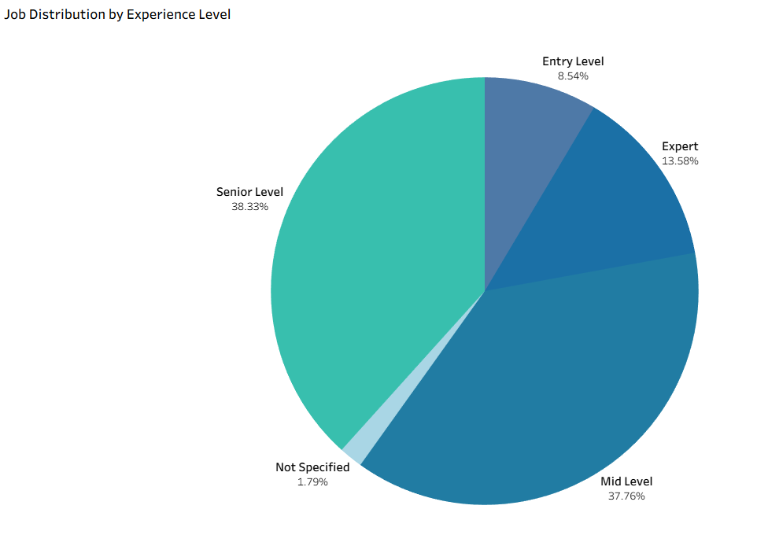
Slide 2
Distribution wise Market
Most jobs sites in India display role categories under following levels :
- Senior level having jobs for Zone managers, top managements etc.
- Mid Level with jobs for leaders, office managers etc.
- Entry Level for freshers, Interns, and people with less to no experience etc.
- Expert for people with experience in specific field. Senior developers, VPs etc.
- Not specified are missing level information.
We can see that Senior level jobs are at 38% of whole market which means we have massive openings for such roles, but entry level roles are merely 8.54%.
Without new opening, it is hard to entry into specific field and start your carrier.
Level determine the salary range and when it is not mentioned, it is tough to determine decision.
2

Slide 4
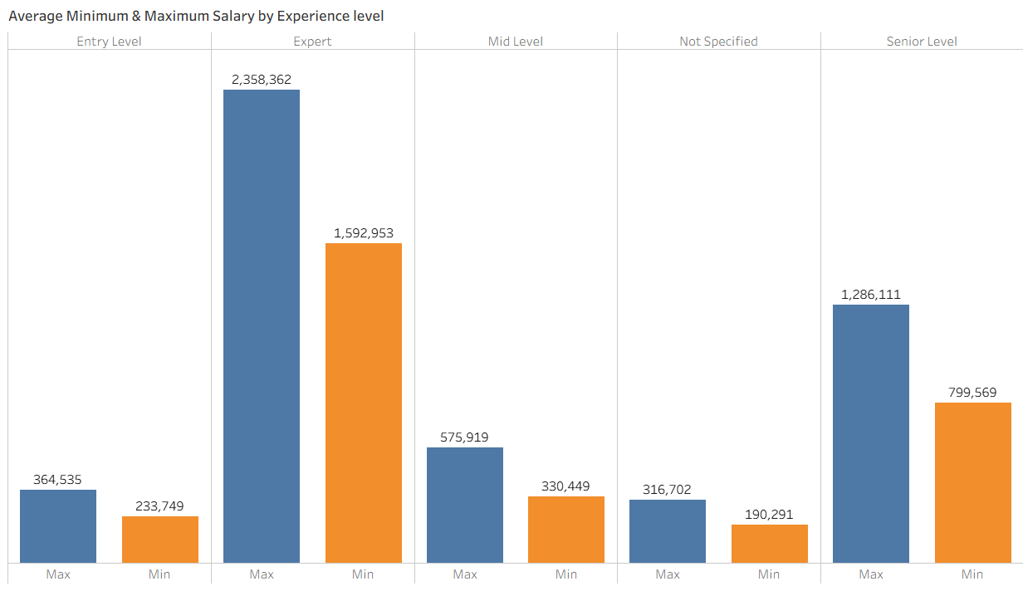
Slide 3
Level to salary
Expert
Senior
Mid
Entry
Experts are earning handsome packages for the experience they have and ease of operations they bring to the table.
Seniors’ usually take on the risk of operations and thus receive good package.
Mid level jobs are for experienced people, but their risk is lower and thus packages are in accordance with their responsibility.
Entry Level jobs are like break in period and people learn about the industry.
We have not specified entries as well
Expert
15 LPA – 23 LPA average
Senior
8 LPA – 13 LPA average
Mid
3 LPA – 6 LPA average
Entry
2 LPA – 4 LPA average
3

Slide 5
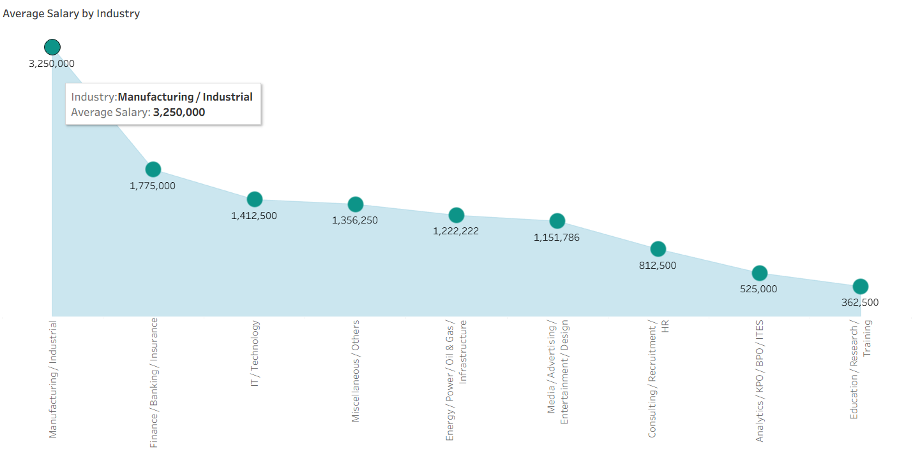
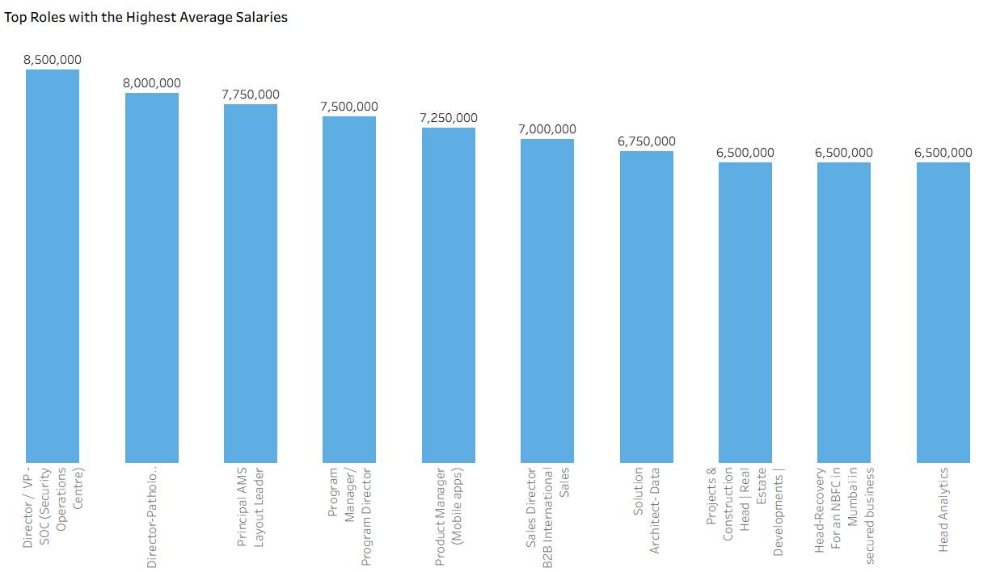
Slide 4
Top picks – Salary.mean()
It is visible that manufacturing industries have highest average salary followed by finance and IT.
Gap between finance and Manufacturing is worth noting.
IT offers good salary to seniors and experts but in India, most base IT jobs does not receive good package thus average is low.
Consulting and HR also pays well.
VPs and directors have highest average salary as they are risk Barrers followed by PMs, Heads and Analysts.
Overall slope of data is almost perfect.
Most top roles are related to top management and share holders which take a lot of experience to reach.
4

Slide 6
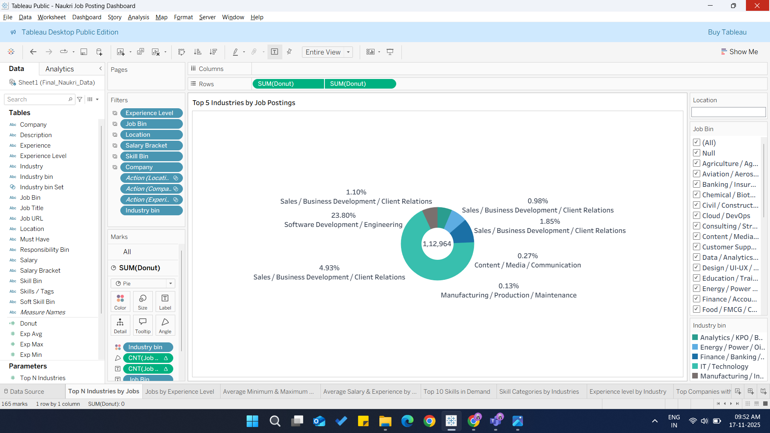
Slide 2
Industry Wise Posting
It is visible that most postings are for tech field particularly Software Development and engineering.
Followed by Sales/PROs but if we look at the difference, we can say that Tech jobs are booming still.
We have already discovered that Manufacturing fields are offering good salary, but we can see here that job opening are very less.
Sales are still relevant even after e-commerce boom.
Media/Content jobs are also relevant, and we can see that content creation is heading towards peek.
5

Slide 7
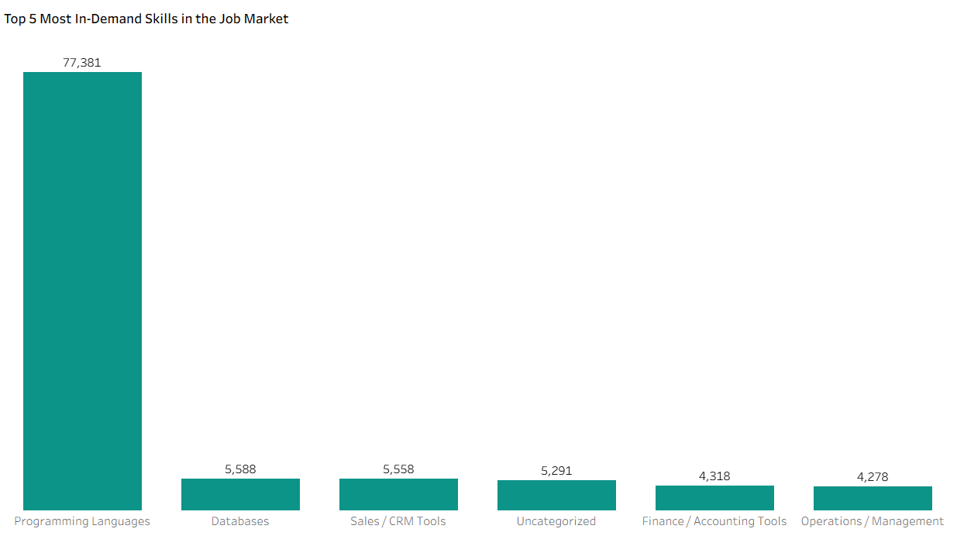
Slide 5
Skills in demand
We can see that most jobs are around programming followed by databases and sales.
The difference we see here between job count of programming and Databases is noticeable.
We can say that finance, sales, programming and Management pays good and a lot of postings are available.
Database jobs are increasing as data is the new oil and lot of companies have big data centers which require engineering. AI also require these.
6

Slide 8
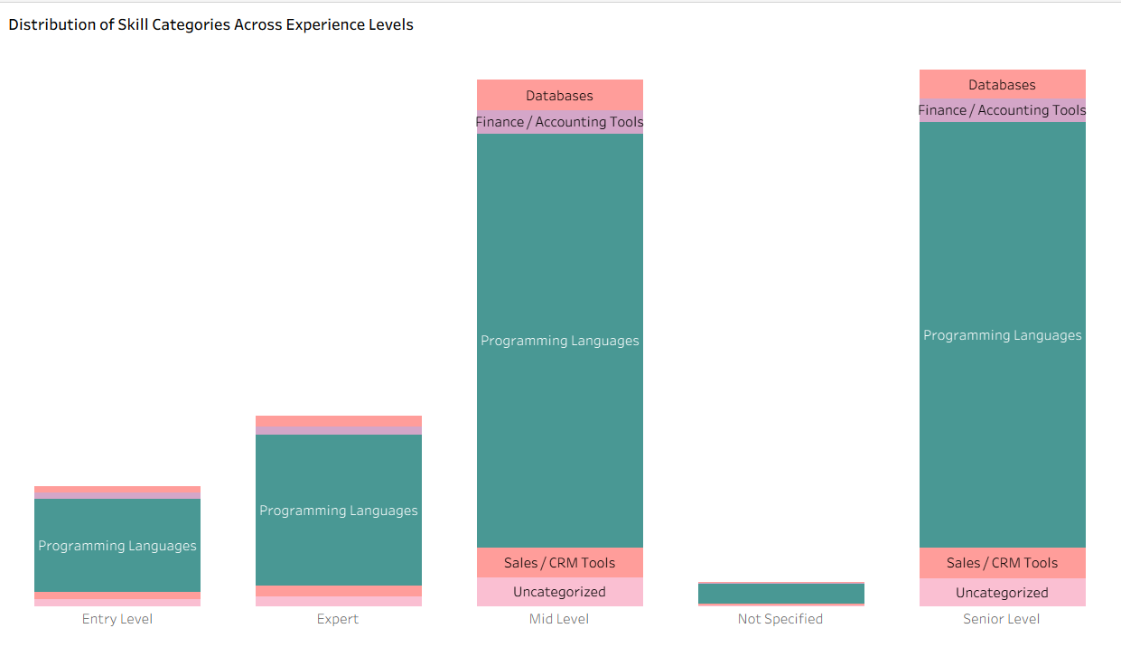
Slide 3
Demand per level
Expert
Senior
Mid
Entry
All levels have programming language related jobs which signifies that market is now ready for more IT jobs followed by database and sales.
Jobs for Mid and Senior level programmers are on peek which could be due to massive lay-off right now.
7

Slide 9


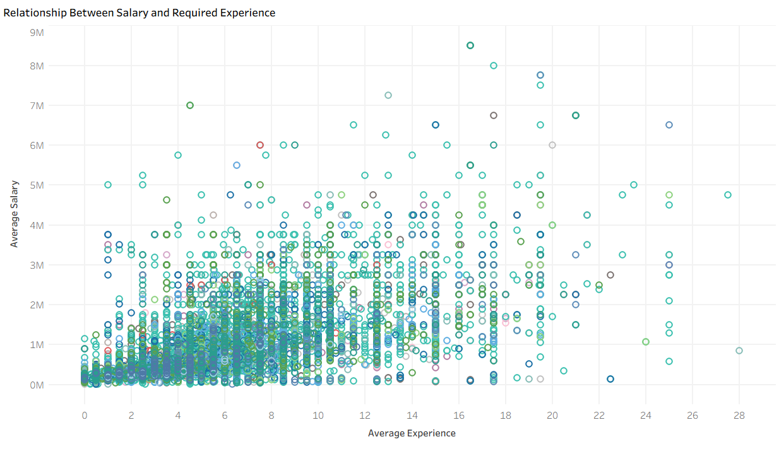
Slide 7
Experience to Salary
• Salary generally increases with experience, but not linearly.
• High salary outliers appear across many experience levels.
• Most roles fall in 0–10 years experience with 0.3M–3M salary.
• Salary variation widens for senior roles.
• Skills, role type & industry influence salary more than experience alone.
8

Slide 10
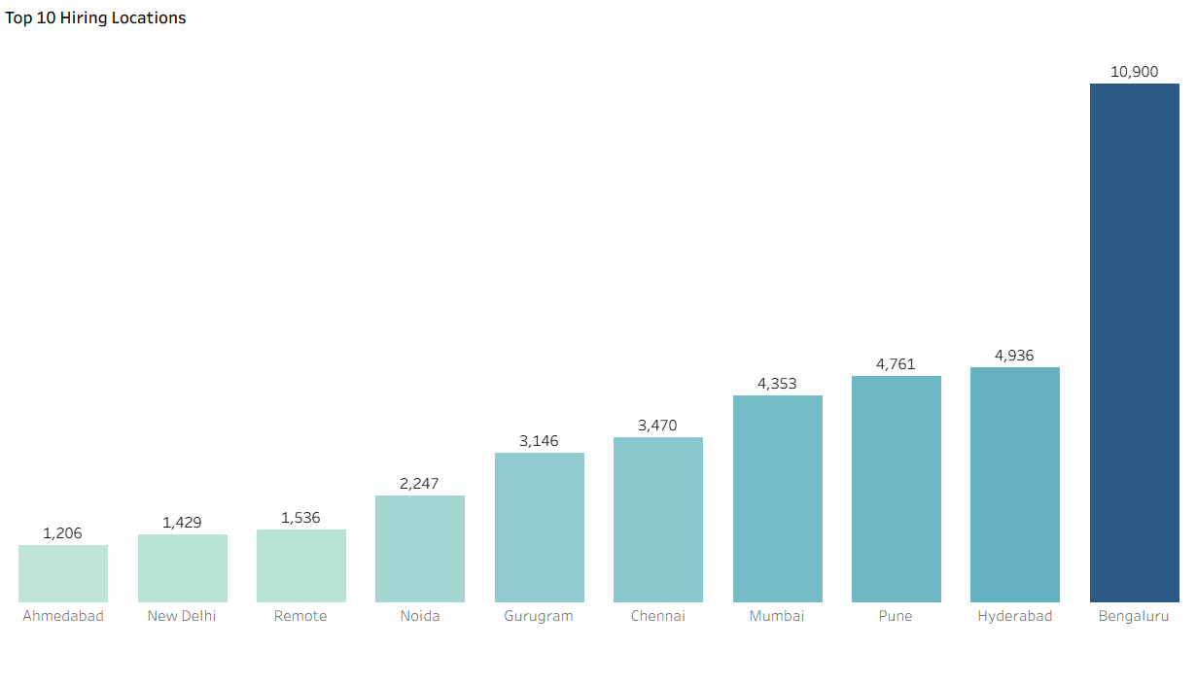
Slide 8
Top locations offering most push
The hiring data clearly highlights Bengaluru as the dominant recruitment hub, with 10,900 hires, which is more than double any other location. This indicates that Bengaluru continues to be India’s primary talent market, especially for technology, digital, and startup ecosystems.
Following Bengaluru, Hyderabad (4,936), Pune (4,761), and Mumbai (4,353) form a strong second tier of hiring activity, reflecting their growing importance as major IT, finance, and enterprise business centers.
Mid-tier cities such as Chennai (3,470) and Gurugram (3,146) also show substantial hiring volumes—suggesting their continued relevance for IT services, consulting, and large-scale corporate operations.
Interestingly, Remote roles (1,536) still appear in the top 10, showing that while hybrid/remote work has declined from pandemic highs, it remains a meaningful hiring category.
Lower-volume hiring locations like New Delhi (1,429) and Ahmedabad (1,206) indicate more niche or specialized recruitment needs.
9

Slide 11
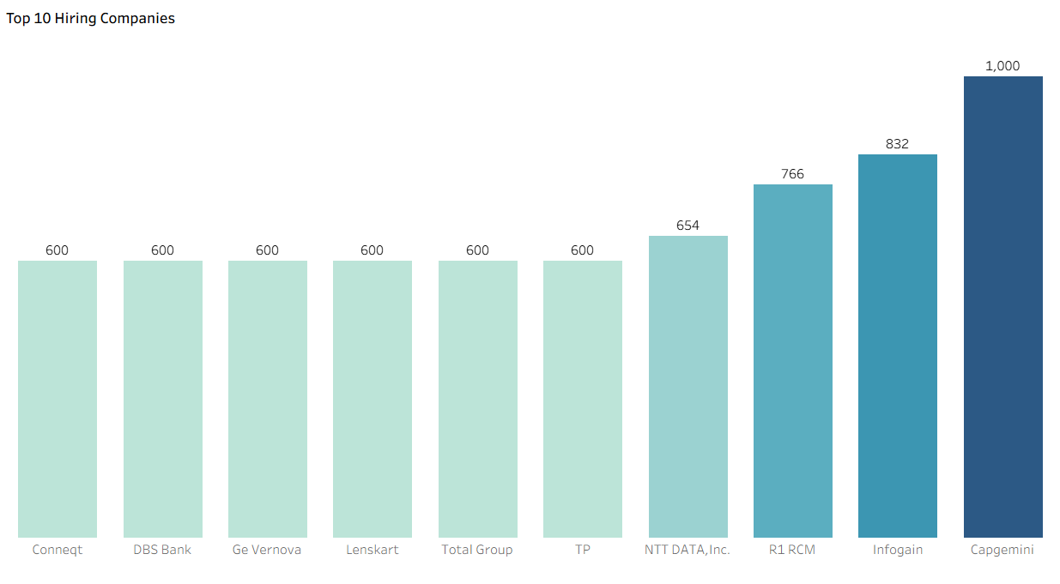
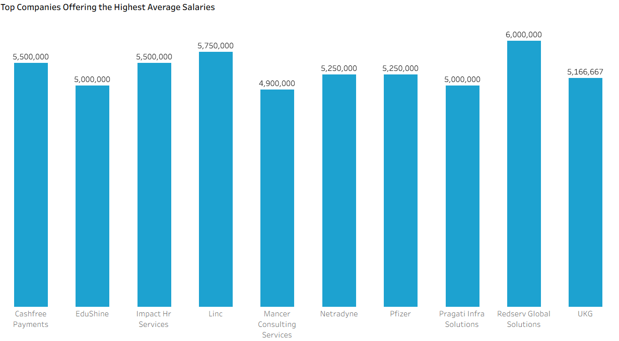
Slide 4
Top Companies
Among the top hiring companies, Capgemini stands out significantly, recruiting 1,000 candidates, far above the rest. This indicates strong business growth and large-scale project requirements within the organization.
Other companies showing moderate but notable hiring activity include:
Infogain (832 hires) – indicating expansion in digital transformation and IT services.
R1 RCM (766 hires) – reflecting strong demand in healthcare revenue cycle management.
NTT DATA, Inc. (654 hires) – suggestive of steady growth in global IT operations.
The rest—Conneqt, DBS Bank, GE Vernova, Lenskart, Total Group, and TP—each hired 600 candidates, showing stable but consistent workforce needs.
Redserv Global Solutions offers the highest average salary at ₹6,000,000, indicating premium roles likely tied to leadership, niche technical skills, or global functions.
Linc (₹5,750,000), Cashfree Payments (₹5,500,000), and Impact HR Services (₹5,500,000) follow closely, showcasing strong compensation in fintech and HR consulting.
Companies like Netradyne and Pfizer offer competitive salaries at ₹5,250,000, which aligns with their high-skill, innovation-focused business models.
EduShine, Mancer Consulting, Pragati Infra Solutions, and UKG also appear in the top list, reflecting strong salary offerings across industries like education consulting, infrastructure, and enterprise HR solutions.
10

Slide 12
Slide 4
Insights
For Companies
For Seeker
Salary Transparency
- Many job ads either omit salary entirely or use vague language (“competitive salary”) instead of providing a meaningful range.
- This frustrates applicants: according to surveys, lack of pay information is one of their top red flags.
- Inconsistent salary disclosures within a company or across departments also create distrust.
Unrealistic or Overwhelming Requirements
- Employers sometimes list too many “must-have” skills or overly long task lists, scaring off potentially good candidates.
- Calling for a decade of experience for a “mid-level” role or demanding every niche certification is a common mistake.
Vague / Generic Job Descriptions & Titles
- Using generic job titles (“Senior Developer”, “Marketing Guru”) or buzzword-heavy language makes it hard for candidates to self-assess fit.
- Internal jargon, acronyms, or overly technical terms can make the posting confusing for external candidates.
Missing or Weak Call-to-Action / Application Process Clarity
- Some ads don’t clearly state what an applicant should do next. Include “Apply here,” “Submit your resume + portfolio,” etc.
- Overly complex application flows (too many pre-screening tasks or lengthy forms) deter candidates.
Possibility of “Ghost Jobs”
- Some employers post “ghost jobs” — ads for roles that may not really exist or are not actively hiring — which wastes applicants’ time.
- These often have vague job descriptions, no timeline, or are repeatedly reposted.
Not Researching or Asking About Compensation & Expectations
- Given that many job ads are vague, applicants sometimes accept that ambiguity rather than proactively asking for a pay range or understanding the total compensation package.
- They should feel empowered to clarify compensation expectations during early conversations.
Skill Relevance vs. “Wish-List” Skills
- Candidates often apply without emphasizing the relevant core skills that the company needs, especially if the job description lists many skills.
- Focusing on key competencies (rather than trying to check every box) makes an application stronger.
Project / Portfolio Visibility
- Applicants do better when they showcase real projects, publicly share their work, or build a portfolio. This demonstrates progress, not just potential.
- Regularly updating LinkedIn, GitHub, or a personal blog with learning progress, side projects, or relevant experiments helps.
Networking and Communication
- Rather than just applying through job boards, following up with hiring managers or recruiters, and building genuine relationships can make a big difference.
- Engaging in communities (meetups, industry events, Slack / Discord groups) helps applicants get on company radars even when job posts are weak.
Understanding the “Red Flags” in Job Posts
- Candidates should be aware of signs like no salary, very vague requirements, or repeatedly reposted roles (possible ghost jobs) — and interpret them cautiously.
- They should prepare to ask clarifying questions in interviews: e.g., “What is the salary band?” or “Is remote work flexible or mandatory on site?”
11

Slide 13
Slide 8
For Companies
For Seeker
Include a clear salary range: Not just “competitive,” but a realistic band or at least a base + upside.
Use a streamlined “easy apply” flow: Make applying simple if your goal is volume and quality.
Be specific about skills & responsibilities: Highlight core, truly required skills, and distinguish them from “nice-to-haves.”
Be transparent about location or relocation expectations: If most roles are in one city, clarify if remote or relocation is possible.
Show your culture: Use language that reflects your company’s values; talk about diversity, career growth, benefits.
Avoid ghost postings: Ensure roles are real, budgeted, and you intend to hire — otherwise, you waste candidate trust.
Continuously build and showcase relevant skills: Use projects, public portfolios, and open-source work to validate your abilities.
Be proactive about compensation discussions: Ask for clarification early; don’t guess or undervalue yourself.
Follow up and network: Don’t rely solely on job boards — reach out to recruiters, hiring managers, or community contacts.
Be discerning about job posts: Learn to spot red flags (no salary, vague role, ghost job indicators) and ask questions.
Keep learning and sharing: Document your progress (blogs, LinkedIn posts, GitHub), which helps you stand out and shows commitment to growth.
RECCOMENDATIONS

Slide 14

Slide 11
THANK YOU

